Slide 1

Database and SQL Commands
Mastering Data Management and Querying for Modern Systems

Slide 2

What is a Database?
A database is an organized collection of data that can be easily accessed, managed, and updated. Think of it as a digital filing cabinet, structured to store information efficiently and reliably.
Example: Students Table
Data is typically stored in tables, with rows representing individual records and columns representing specific attributes.
ID
Name
Age
Grade
1
John
20
A
2
Priya
19
B
3
Ahmed
21
A
4
Neha
18
C
Databases are the backbone of almost every application, from social media to online banking, ensuring data integrity and quick retrieval.

Slide 3
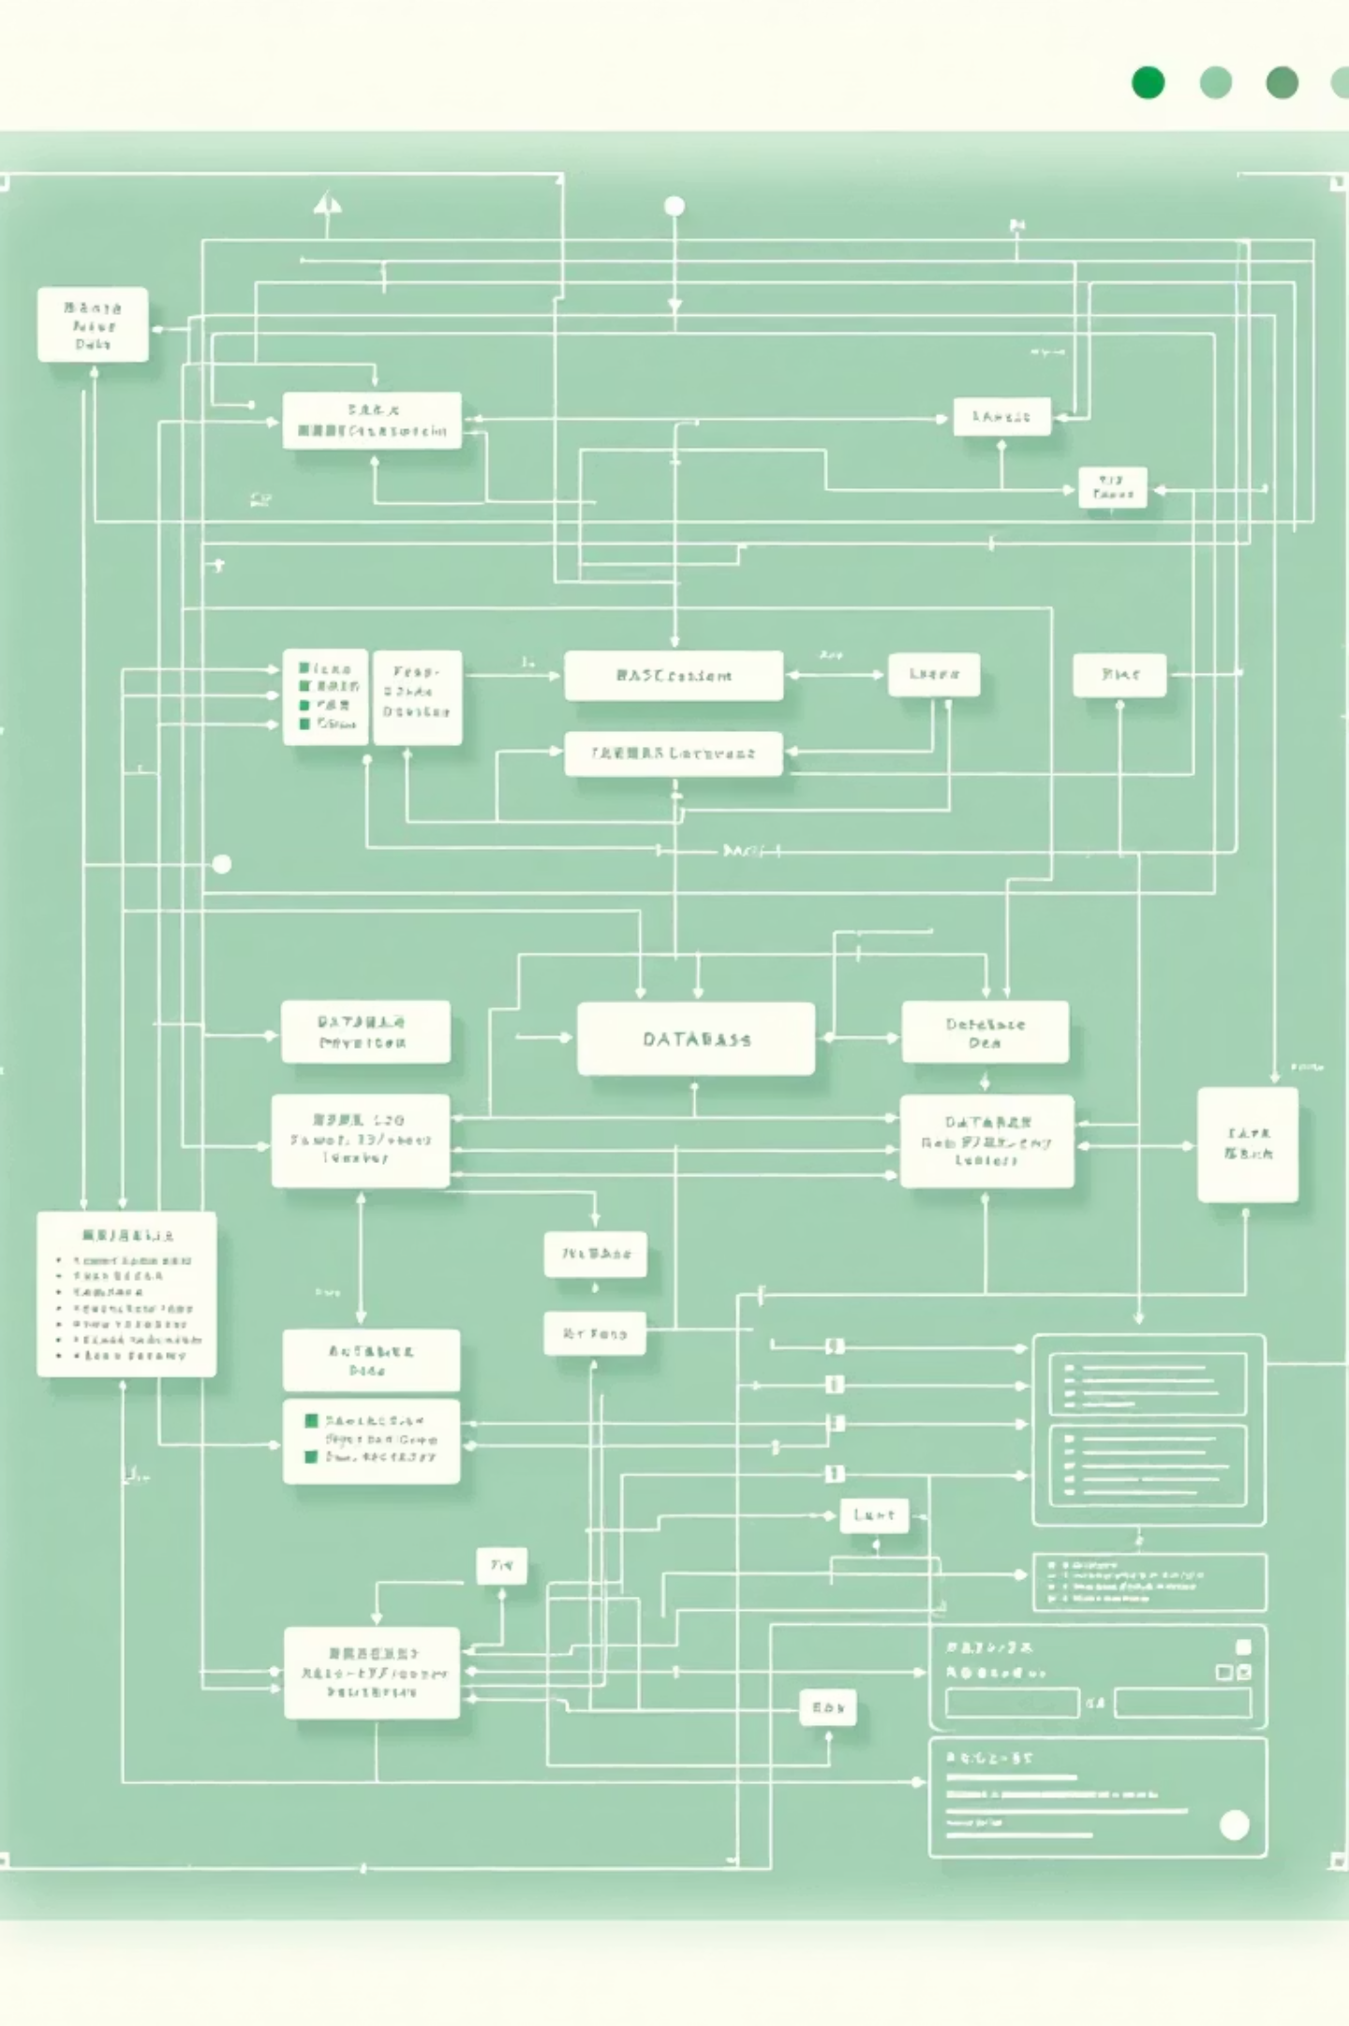
DDL: Data Definition Language (DDL)
Data Definition Language (DDL) commands are used to define, modify, and manage the structure of database objects, such as tables. They essentially build the schema or blueprint of your database.
CREATE
1
Used to create new database objects, like tables, views, or indexes.
CREATE TABLE Students(ID INT, Name VARCHAR(50), Age INT, Grade CHAR(1));
ALTER
Used to modify the structure of an existing database object, such as adding a new column to a table.
2
ALTER TABLE Students ADD Address VARCHAR(50);
DROP
Used to delete an entire database object from the database, permanently removing its structure and data.
3
DROP TABLE Students;

Slide 4


DML: Data Manipulation Language
Data Manipulation Language (DML) commands are used for managing data within database objects. These commands allow you to insert, update, and delete records, interacting directly with the information stored.
INSERT
UPDATE
Adds new rows or records into a table.
Modifies existing data within one or more rows of a table.
INSERT INTO Students VALUES(5,'Sara',20,'B');
UPDATE Students SET Grade='A+' WHERE ID=2;
DELETE
Removes one or more rows from a table based on specified conditions.
DELETE FROM Students WHERE ID=4;
These DML commands are essential for keeping your database content current and relevant.

Slide 5
DQL: Data Query Language (DQL),
Data Query Language (DQL), primarily represented by the SELECT statement, is used to retrieve data from a database. This is where you extract the insights from your stored information.
Select All Records
Select with ORDER BY
SELECT * FROM Students;
SELECT * FROM Students ORDER BY Name ASC;
Retrieves every column and row from the table.
Sorts the result set by one or more columns.
Select Specific Columns
Aggregate Functions (COUNT, AVG, MAX)
SELECT Name, Grade FROM Students;
SELECT COUNT(*) AS TotalStudents FROM Students;
Only fetches the specified columns.
Performs calculations on a set of rows.
Select with Condition (WHERE)
Select with GROUP BY
SELECT * FROM Students WHERE Age > 18;
SELECT Grade, COUNT(*) FROM Students GROUP BY Grade;
Filters rows based on a specific condition.
Groups rows that have the same values in specified columns.
Select with LIKE (Pattern Matching)
SELECT * FROM Students WHERE Name LIKE 'A%';
Searches for patterns in text columns.

Slide 6

Connecting Data: Understanding SQL JOINs
When data is spread across multiple related tables, JOIN clauses are used to combine rows from two or more tables based on a related column between them. This is crucial for retrieving comprehensive information.
Tables for JOIN Examples:
INNER JOIN
LEFT JOIN (LEFT OUTER JOIN)
Students Table:
Returns rows when there is a match in both tables. Only students with courses, and courses with students.
Returns all rows from the left table, and matching rows from the right table. If no match, NULL for right columns.
ID
Name
1
John
SELECT S.Name, C.CourseName FROM Students S INNER JOIN Courses C ON S.ID = C.StudentID;
SELECT S.Name, C.CourseName FROM Students S LEFT JOIN Courses C ON S.ID = C.StudentID;
2
Priya
3
Ahmed
4
Neha
RIGHT JOIN (RIGHT OUTER JOIN)
Returns all rows from the right table, and matching rows from the left table. If no match, NULL for left columns.
Courses Table:
SELECT S.Name, C.CourseName FROM Students S RIGHT JOIN Courses C ON S.ID = C.StudentID;
CourseID
CourseName
StudentID
101
Math
1
102
Science
2
103
English
1
104
History
3

Slide 7

SQL Commands: A Comprehensive Overview
SQL commands are categorized based on their function, allowing for structured interaction with databases.
DDL: Data Definition Language
Commands like CREATE, ALTER, DROP are used to define and modify the database structure.
CREATE TABLE Students(...);
DML: Data Manipulation Language
Commands such as INSERT, UPDATE, DELETE are used to manage the data within tables.
INSERT INTO Students VALUES(...);
DQL: Data Query Language
Primarily the SELECT statement, used for retrieving specific data from tables.
SELECT * FROM Students WHERE Age > 18;
Understanding these categories is key to effective database management and powerful data querying.

Slide 8

Thank You!
We appreciate your attention and hope this overview helps you embark on your database journey.
Any Questions?

